Slide 1
Logo animation (intro)

Slide 2





















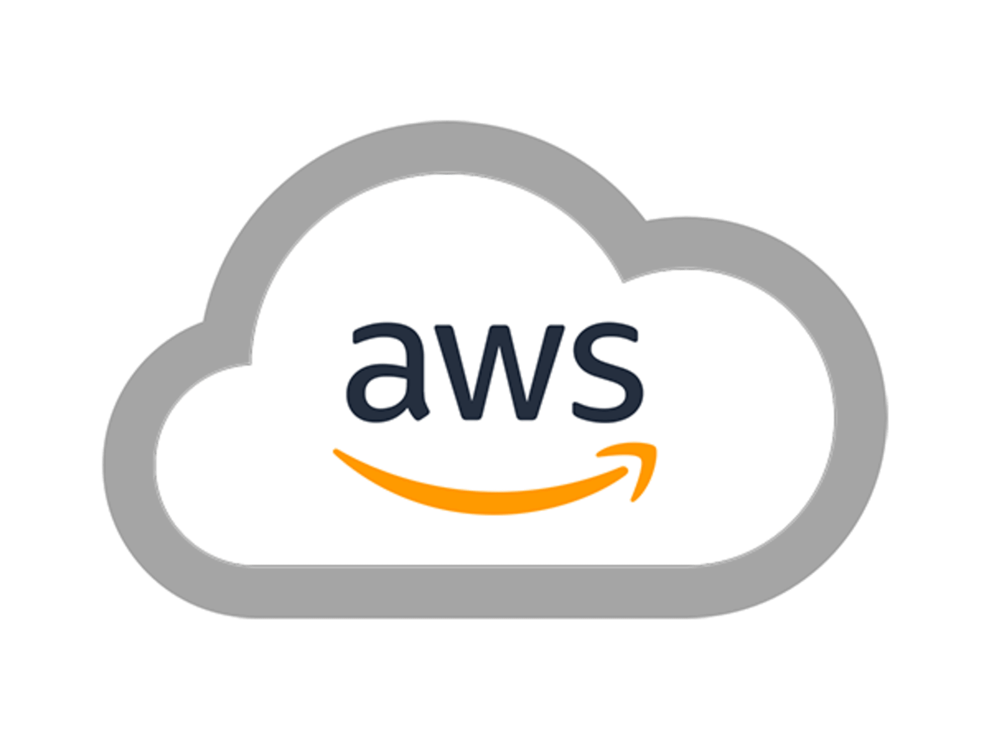



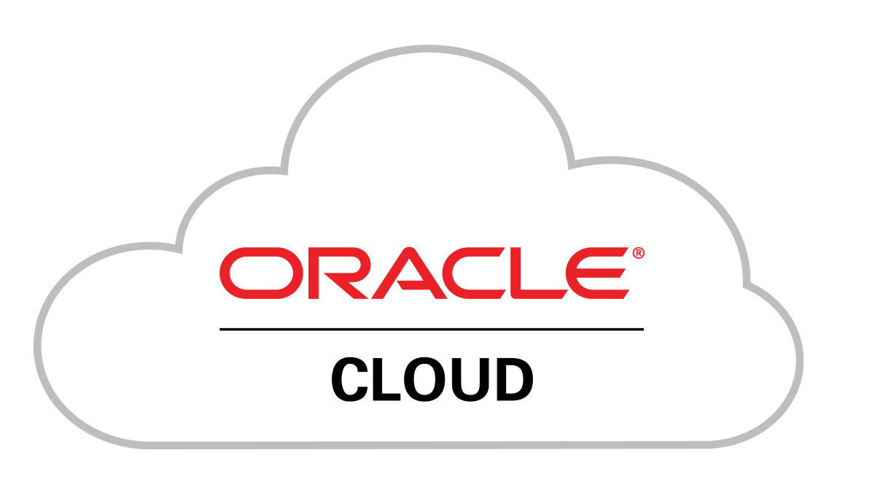


Title slide
Introducing Steampipe - select * from cloud
Lucas Jellema, CTO Conclusion
Notes:
Retrieving the current status of cloud resources, checking validity of infrastructure as code definitions, comparing configuration of platform resources in different environments: all of this can be a hassle. With CLIs, REST APIs, configuration files, probably throwing in some spreadsheets. It is not that straightforward to quickly learn the actual situation in a usable format. Or is it? Enter Steampipe. This tool allows us to write plain SQL queries to retrieve AWS EC2 instance settings, Azure Functions configurations, Google Storage Bucket details as well as data from over 150 other platforms, servers, tools and file formats. Multiple assets can be inspected in a single query, with data filtered (WHERE), aggregated (GROUP BY), and combined (JOIN, UNION, MINUS) with regular SQL syntax. Steampipe leverages PostgreSQL and its foreign data wrapper mechanism to turn these SQL queries into the appropriate API calls. This session shows you how to get started with Steampipe, how to use it in CLI and batch mode, how to combine it with regular SQL tables. It introduces the mods for quality checks and dashboards for overviews on top of the Steampipe plugins. Finally you will see a glimpse of how easy it is to write your own Steampipe plugin - to add select * from "your favorite type of resource". Pitch: Steampipe is a simple and lightweight tool that makes it dead easy to inspect hundreds of different types of resources using plain SQL. These resources can be VMs, databases, storage units or any other type in all public clouds, as well as folders in a mail server, repositories on GitHub, Profiles on LinkedIn, Toots on Mastodon or Pods on Kubernetes. With Steampipe, you can forget about CLIs, REST APIs and a zillion different configuration file formats.

Slide 3



















Introducing Conclusion Ecosysteem
Notes:
an ecosystem of autonomous companies that try to find synergy in working together

Slide 4
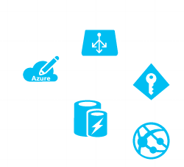
Get info on cloud resources
API
CLI
SDK
UI
challenges:
connections
commands
format
automate
?

Slide 5






















Next platform or even resource
Same challenge requiring a different API|SDK|CLI|UI

Slide 6

Basic assumption: everyone does SQL
what is the most common way to retrieve and analyze data?
SQL

Slide 7
steampipe turns every api into a SQL target
SQL

Slide 8
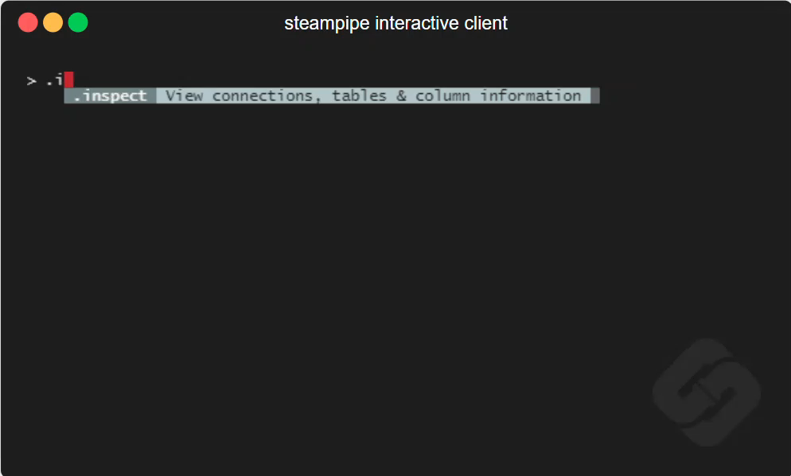

Slide 9
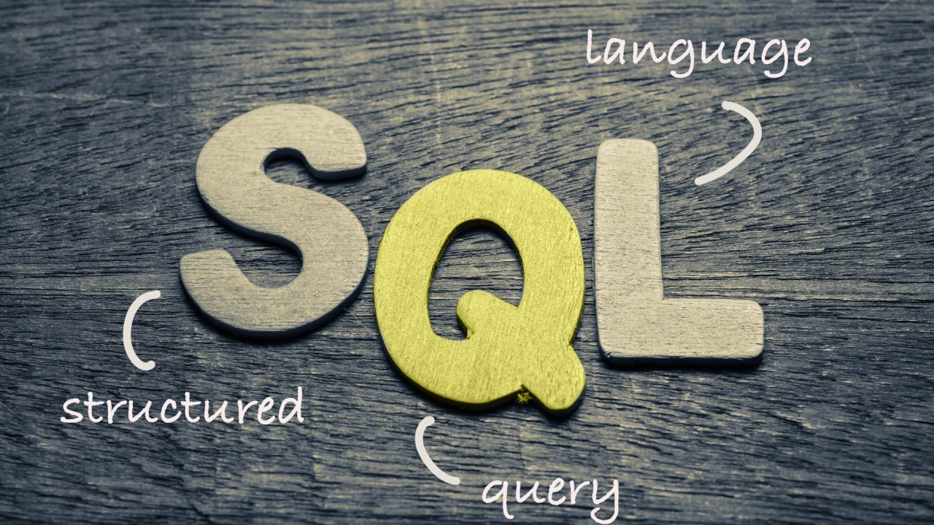
What does the SQL allow us to do?
fetch
format, convert
filter
sort
aggregate

Slide 10
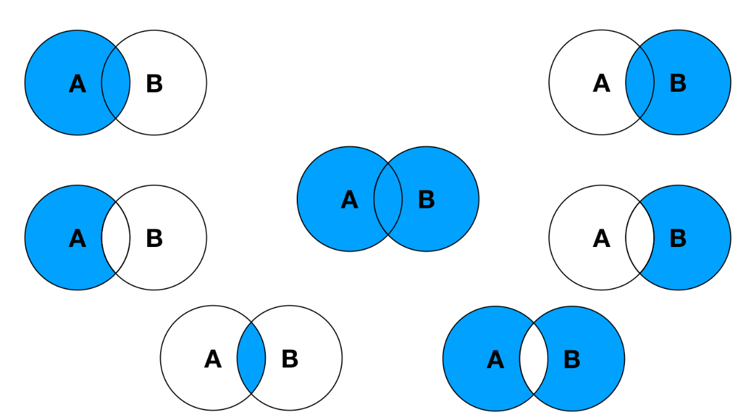
and also…
JOIN
enrich, compare, consolidate
Across resources
Across connections
Across clouds & platforms
With regular database tables & views

Slide 11

Using Steampipe
Install (either stand alone application or container image)
add plugins
Run queries through
CLI
Batch mode (as code)
through a regular database connection
Get output as output text, csv, json

Slide 12
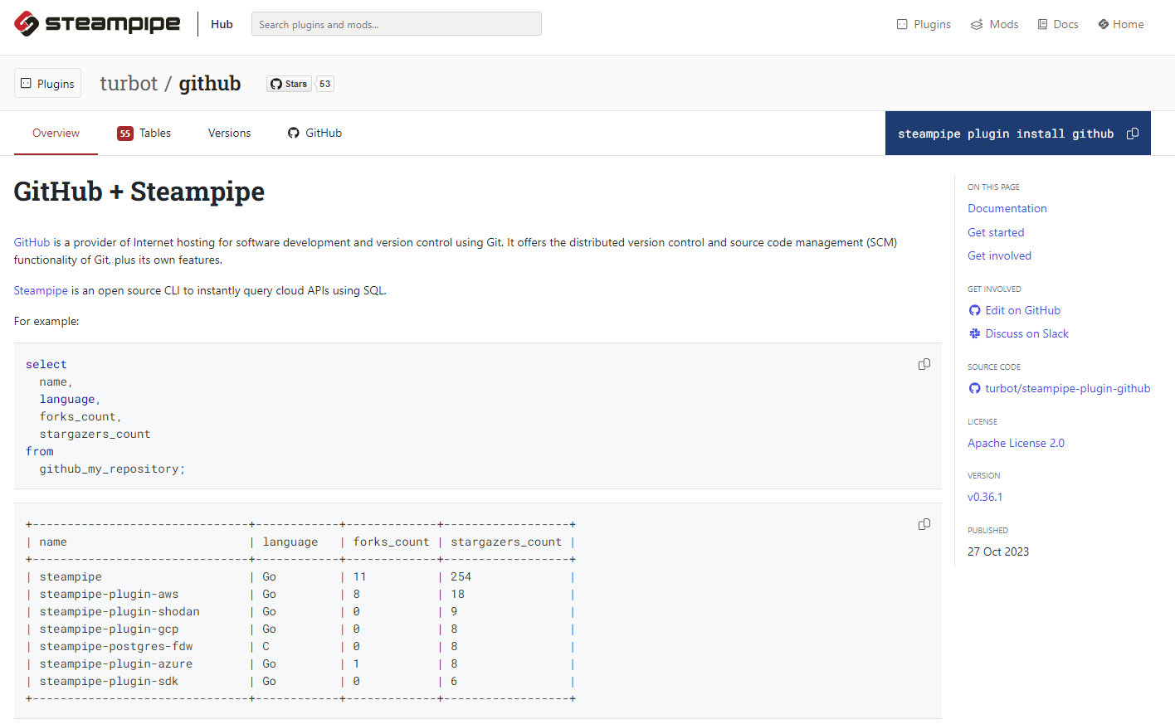

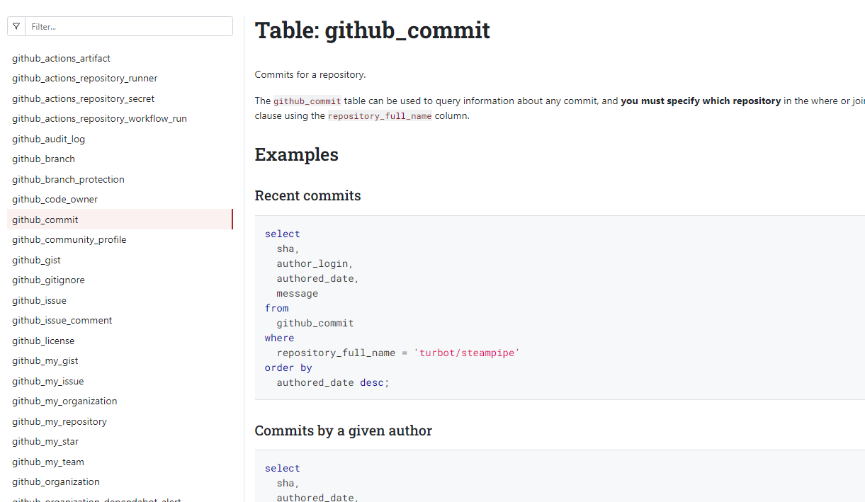
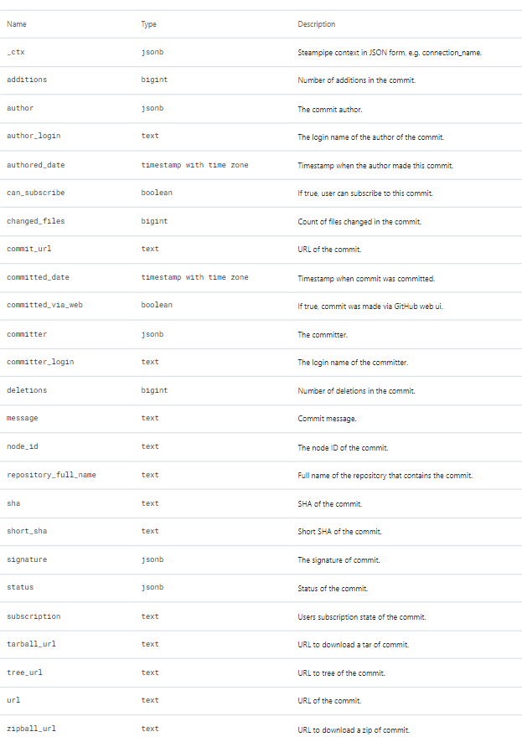
Example of plugin [documentation]

Slide 13
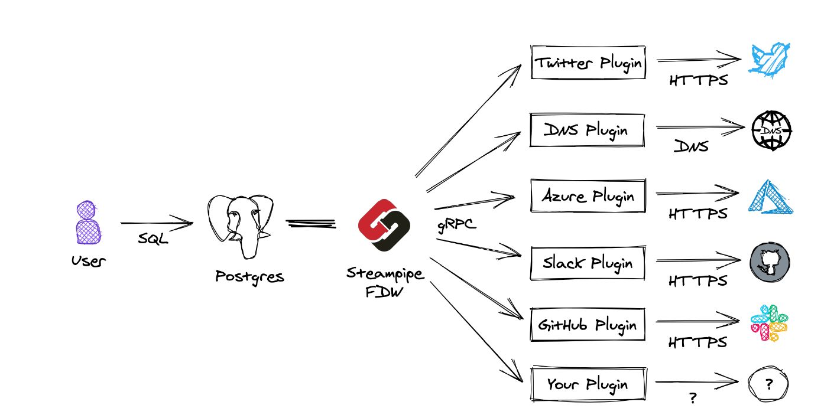
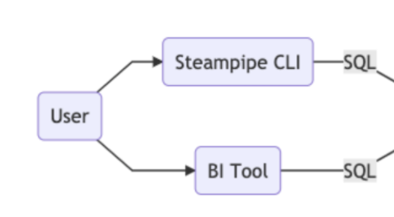
Steampipe under the hood

Slide 14

Steampipe under the hood

Slide 15
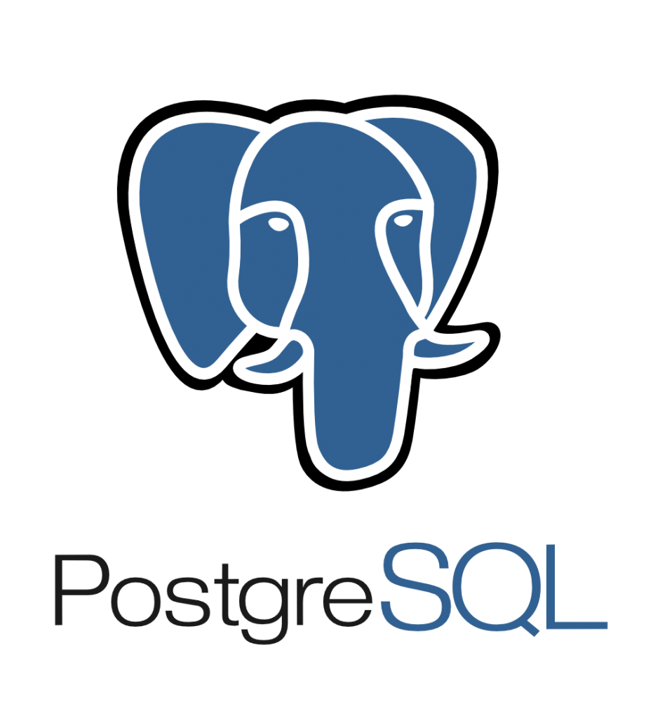
Steampipe is accessible as a regular postgresql database
All the power of PostgreSQL SQL
Every plugin corresponds to a schema in PostgreSQL
every resources to a View
Data caching
Easy “snapshotting”

Slide 16
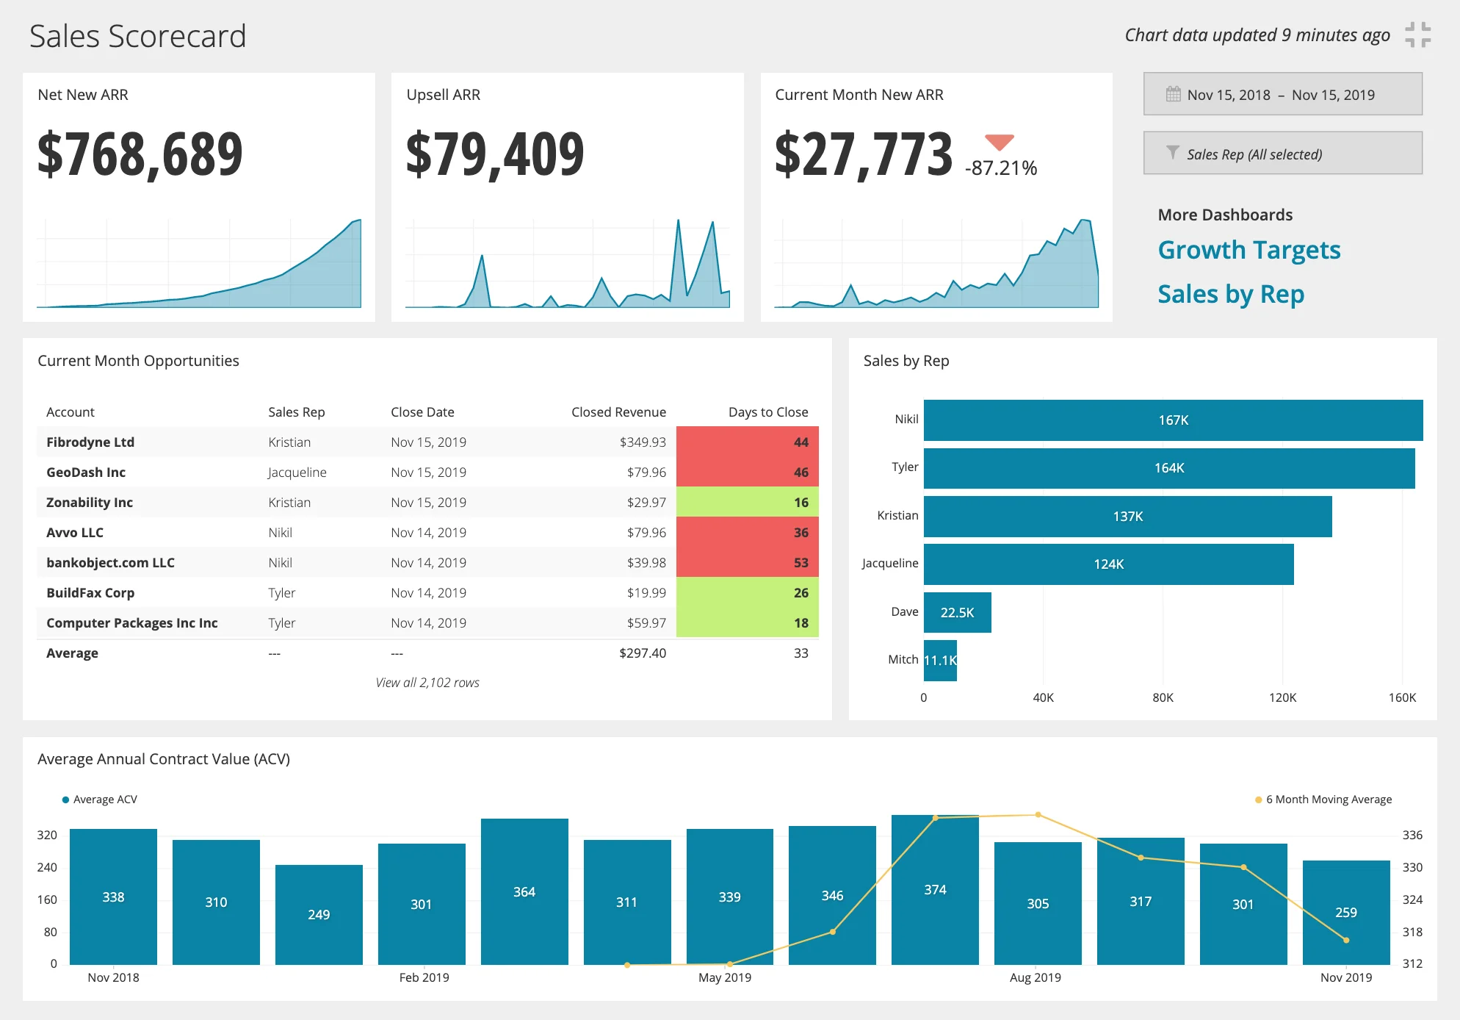
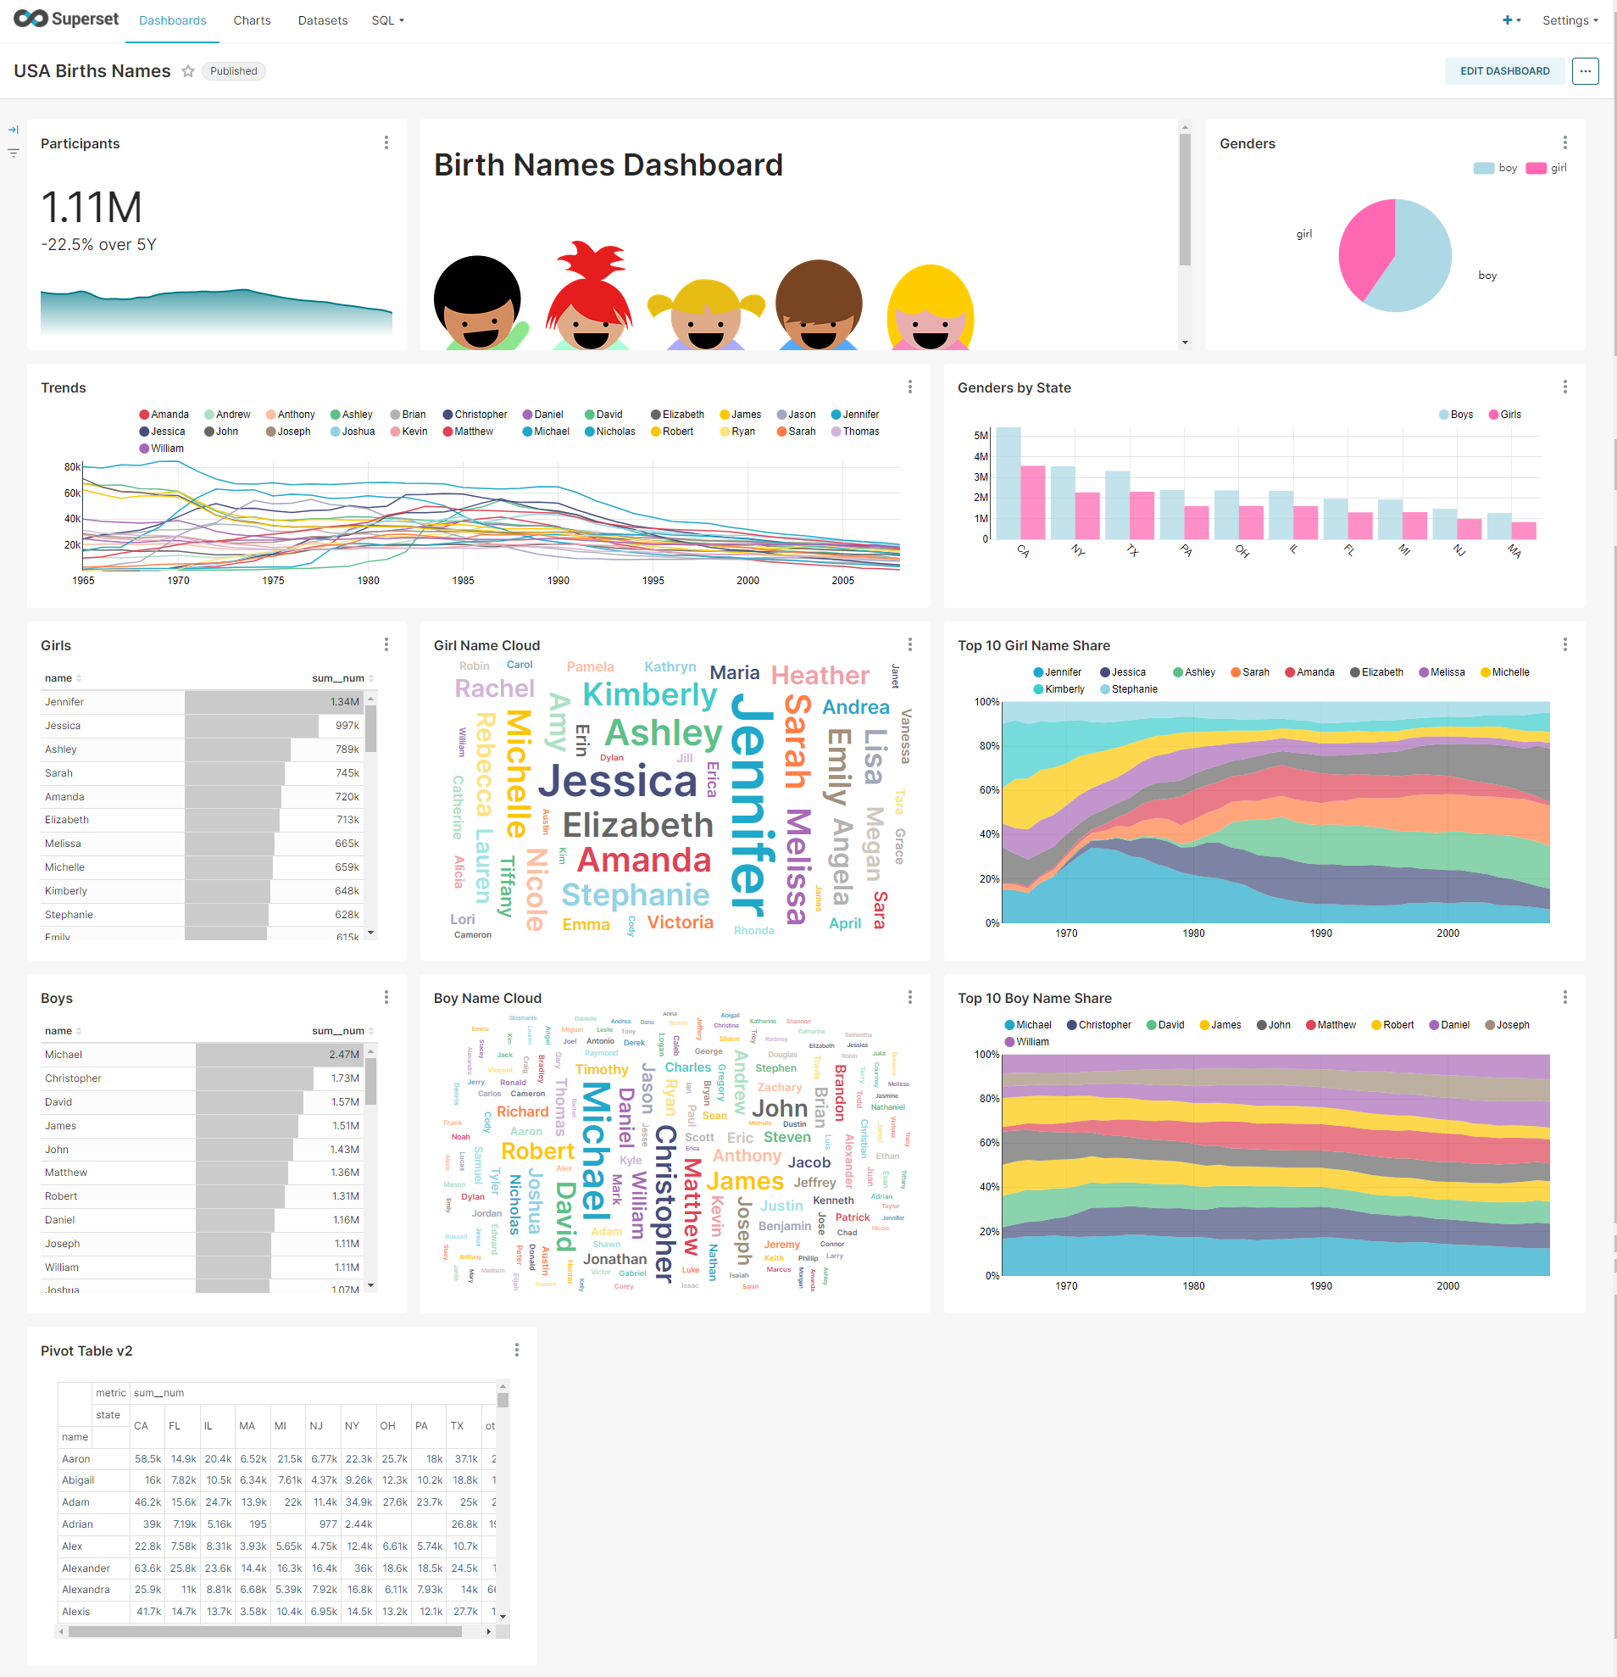








Tools on top of Steampipe
Any tool that does SQL
BI tools
Your custom web application
Dashboards
Reports
SQL

Slide 17

Conclusion
with vms as ( select cost_tag label
, application_tag
from AWS_VMs where status = ACTIVE
union all
select department_label
, application_tag
from TERRAFORM_PLANS
where resource_type = VM
)
select label
, count(*) instance_count
from vms
left outer join
KUBERNETES_PODS
on (vms.application_tag = pods.app_label)
where KUBERNETES_PODS.id IS NULL
group by label
order by label

Slide 18
Logo
www.conclusion.nl

